Slide 1
Advanced Topics Overview
Avanade ASG Data Science Bootcamp

Slide 2
Agenda
1
2
3
4
5
6
Computer Vision
7
Model Interpretability
Sebastian
Sahana
Natural Language Processing
Nesli
Graph Neural Networks
Sebastian
Recommender Systems
Kavita
Generative Adversarial Networks
Laura
Deep Reinforcement Learning
Xiang
Notes:
Blue: need Azure

Slide 3
Computer Vision (CV)
Definition, Overview, Example Applications, Convolutional Neural Networks, Resources

Slide 4
Computer Vision Overview (1)
Computer Vision is defined as the field of study that seeks to develop techniques to help computers “see” and understand the content of digital images (incl. videos). At an abstract level, the goal of computer vision problems is to use the observed image data to infer something about the world. (https://machinelearningmastery.com/what-is-computer-vision/).
Typically, developed methods attempt to reproduce the capability of human vision. As such it can be called a subfield of artificial intelligence.
Notes:
- Computer Vision is not Image Processing (digital signal processing that is not concerned with understanding the content) but Image Processing regularly is part of Computer Vision.
- Anecdote: Making a computer see was something that leading experts in the field of Artificial Intelligence thought to be at the level of difficulty of a summer student’s project back in the sixties. Forty years later the task is still unsolved and seems formidable.

Slide 5
Computer Vision Overview (2)
Vision is trivially solved by even very young children, but it is surprisingly challenging for computers to deal with the complexity of a dynamic and nearly infinitely varying physical world.
One of the reasons is that we don’t have a strong grasp of how biological vision works (like with pretty much everything that involves the brain).
Another reason is that humans collect context over their lifetimes which informs human vision but is not yet adequately reflected in computer vision systems.
While there are still many challenges to be solved in Computer Vision, deep learning has taken over the field, rendering traditional statistical and ML approaches practically irrelevant.
With deep learning, constrained problems can be easily solved.
Notes:
- Computer Vision is not Image Processing (digital signal processing that is not concerned with understanding the content) but Image Processing regularly is part of Computer Vision.
- Anecdote: Making a computer see was something that leading experts in the field of Artificial Intelligence thought to be at the level of difficulty of a summer student’s project back in the sixties. Forty years later the task is still unsolved and seems formidable.

Slide 6
How is Computer Vision Useful?
Abundance of digital image and video data (Internet, IoT) through technological advances led to many value-generating use cases:
Indexing and searching images and videos
Optical character recognition (OCR)
Robot navigation
Industrial inspection and maintenance
Automated retail checkouts
Medical imaging
Autonomous driving and automotive safety
Surveillance and military intelligence
Human computer interaction
Biometrics
Realistic rendering of computer graphics
…

Slide 7
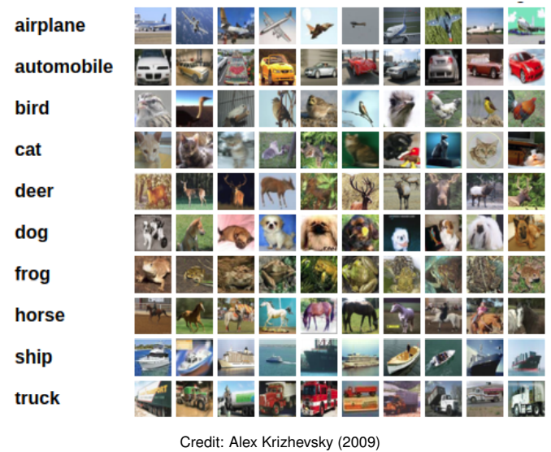
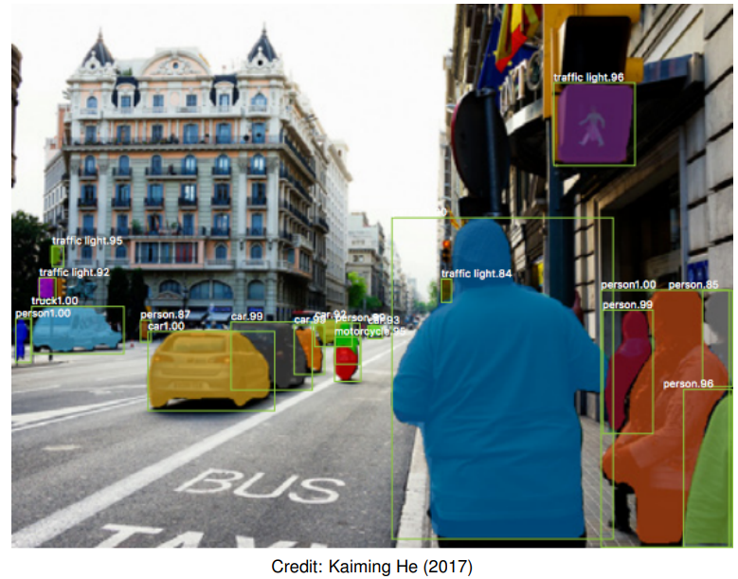
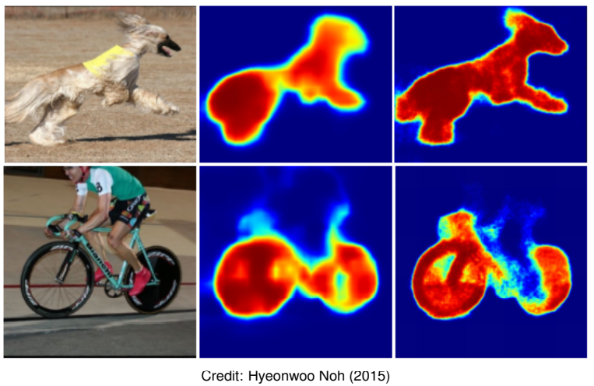
Computer Vision Tasks
Image Classification: What broad category of object is in this photograph?
Object Identification: Which type of a given object is in this photograph?
Object Verification: Is the object in the photograph?
Object Detection: Where are the objects in the photograph?
Object Landmark Detection: What are the key points for the object in the photograph?
Object Segmentation: What pixels belong to the object in the image?
Object Recognition: What objects are in this photograph and where are they?
Image classification: predict a single label for each image
Object detection: generate bounding boxes for each instance
Instance segmentation: partition the image into segments

Slide 8
Computer Vision Algorithms & Methods
Nowadays, there are 2 main algorithms dominating the computer vision field, both deep-learning based:
Convolutional Neural Networks
Vision Transformers
Transfer learning and self-supervised learning (particularly contrastive learning) are key methods to reach success in computer vision tasks.
Transfer learning: Transfer learning is a machine learning technique where a model trained on one task is re-purposed on a second related task.
Self-supervised learning: A form of unsupervised learning where the data provides the supervision
Contrastive learning: Contrastive learning is a machine learning technique used to learn the general features of a dataset without labels by teaching the model which data points are similar or different (very good article: https://towardsdatascience.com/understanding-contrastive-learning-d5b19fd96607).
ImageNet is the biggest labeled image database with approx. 15 million images of 21,000 classes (labeled through 49,000 Amazon Mechanical Turk workers) -> https://www.image-net.org/
This resource is very often used for pre-training computer vision models with transfer learning.

Slide 9
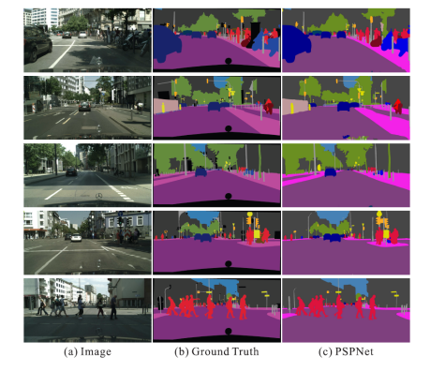
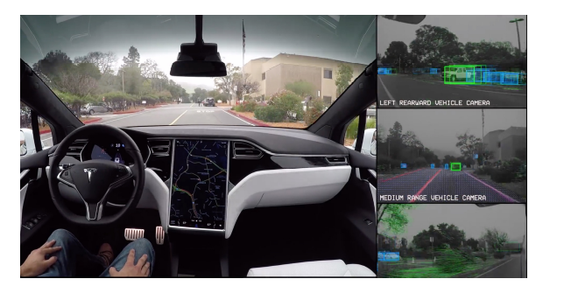
Computer Vision Example Applications
Figure: All Tesla cars being produced now have full self-driving hardware (Source: Tesla website). A convolutional neural network is used to map raw pixels from a single front-facing camera directly into steering commands. The system learns to drive in traffic, on local roads, with or without lane markings as well as on highways.
Figure: Given an input image, a CNN is first used to get the feature map of the last convolutional layer, then a pyramid parsing module is applied to harvest different sub-region representations, followed by upsampling and concatenation layers to form the final feature representation, which carries both local and global context information. Finally, the representation is fed into a convolution layer to get the final per-pixel prediction. (Source: pyramid scene parsing network, by Zhao et. al, CVPR 2017)

Slide 10
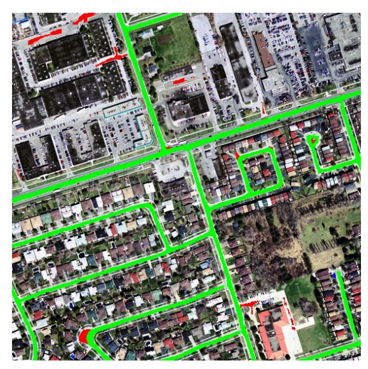
Computer Vision Example Applications
Figure: Road segmentation (Mnih Volodymyr (2013)). Aerial images and possibly outdated map pixels are segmented.

Slide 11
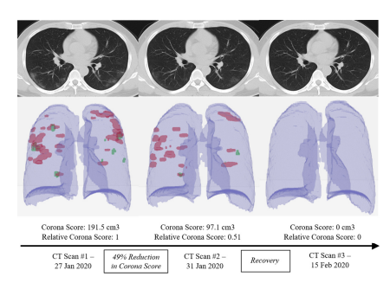
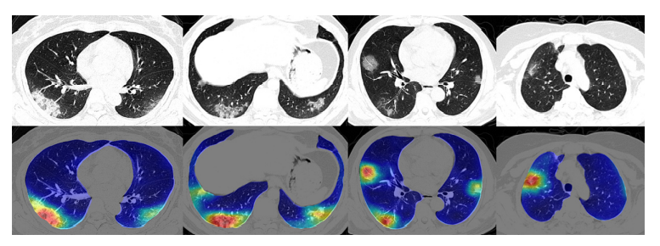
Computer Vision Example Applications
Figure: Four COVID-19 lung CT scans at the top with corresponding colored maps showing Corona virus abnormalities at the bottom (Source: Megan Scudellari, IEEE Spectrum 2021).
Figure: CNN based method (RADLogists) for personalized Covid-19 detection: three CT scans from a single Corona virus patient diagnosed by RADLogists

Slide 12
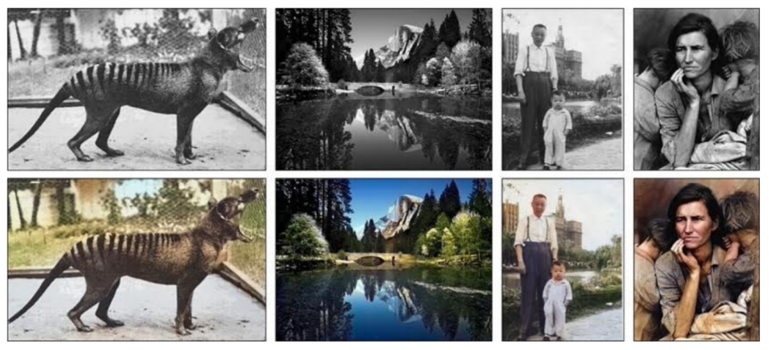
Computer Vision Example Applications
Figure: Image Colorization is another interesting application of CNN in computer vision (Zhang et al. (2016)). Given a grayscale photo as the input (top row), this network solves the problem of hallucinating a plausible color version of the photo (bottom row, i.e. the prediction of the network).

Slide 13
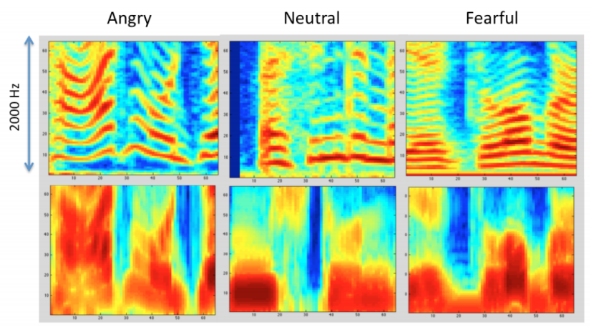
Computer Vision Example Applications
Figure: Speech recognition (Anand & Verma (2015)). Convolutional neural network is used to learn features from the audio data in order to classify emotions.

Slide 14
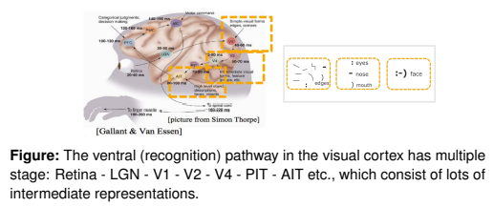
Recap: Convolutional Neural Networks
Convolutional Neural Networks (CNNs, or ConvNets) are a powerful family of neural network architectures in which the connectivity pattern between neurons resembles the organization of the mammal visual cortex.
Basic idea: a CNN automatically extracts visual, or, more generally, spatial features from the input data such that it is able to make the optimal prediction based on the extracted features.

Slide 15
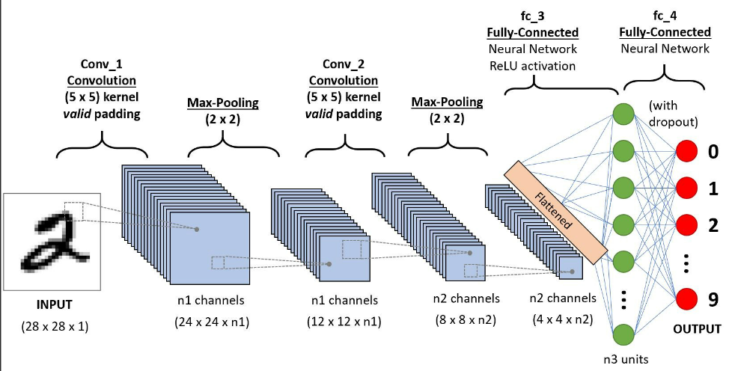
Recap: Convolutional Neural Networks
Input layer takes input data (e.g. image).
Convolution layers extract feature maps from the previous layers.
Pooling layers reduce the dimensionality of feature maps and filter meaningful features.

Slide 16
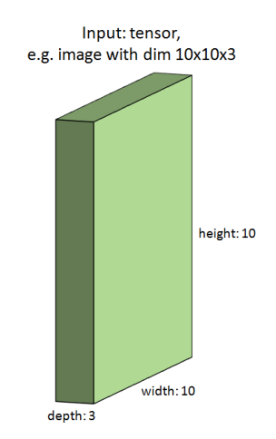
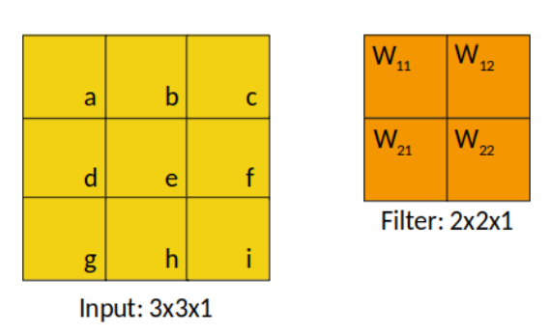
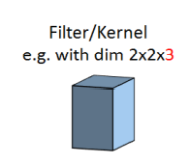
Convolutional Neural Networks
An image is represented by an input tensor, for example with dimensions 10 × 10 × 3 (3 color channels).
We have a learnable filter of size 2.
Or alternatively a 2D visualization of a very tiny greyscale image
Notes:
- Nice to work together in a bigger team of data science enthusiasts

Slide 17
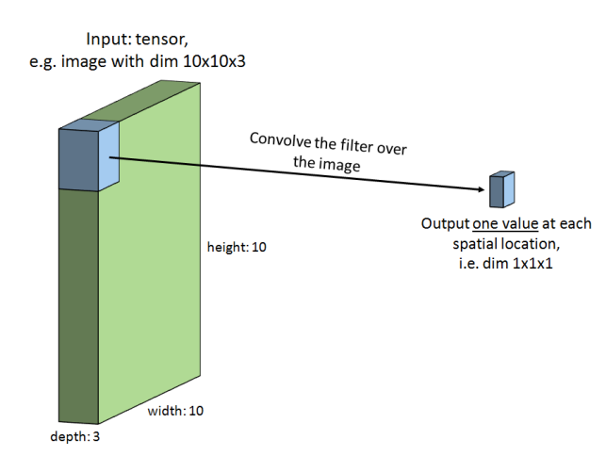
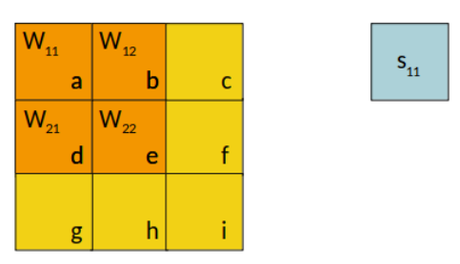
Convolutional Neural Networks
We convolve the filter over the first spatial location, yielding a scalar value.
This is just matrix multiplication again…
Notes:
- Nice to work together in a bigger team of data science enthusiasts

Slide 18
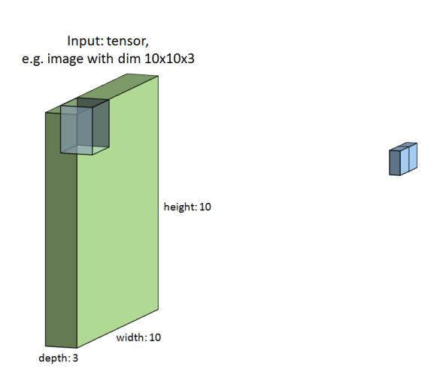
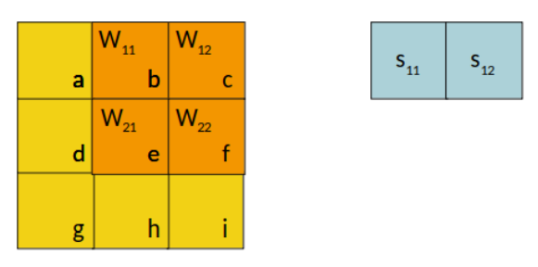
Convolutional Neural Networks
The we shift the filter to the next spatial location.
Notes:
- Nice to work together in a bigger team of data science enthusiasts

Slide 19
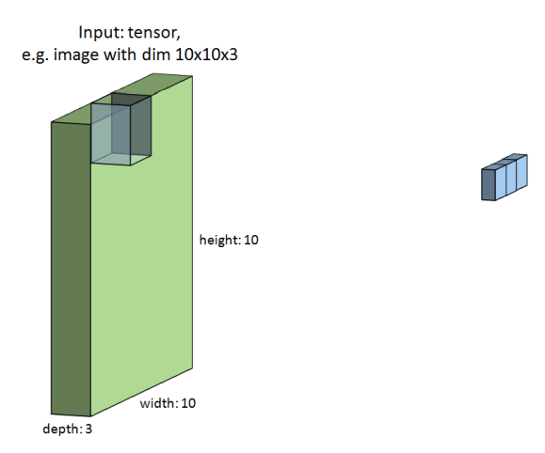
Convolutional Neural Networks
And the next…
Notes:
- Nice to work together in a bigger team of data science enthusiasts

Slide 20
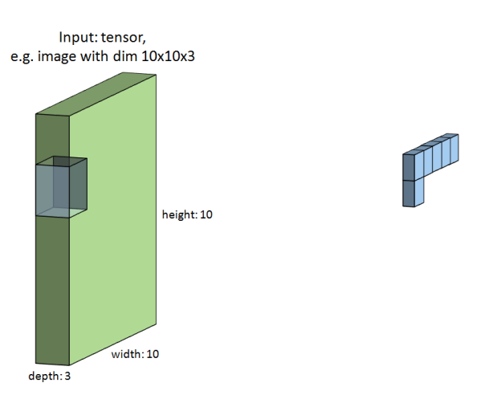
Convolutional Neural Networks
And so on…
Notes:
- Nice to work together in a bigger team of data science enthusiasts

Slide 21
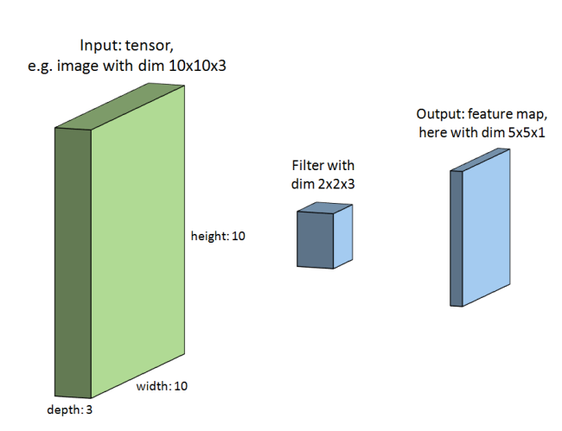
Convolutional Neural Networks
Finally, we obtain an output feature map.
Notes:
- Nice to work together in a bigger team of data science enthusiasts

Slide 22
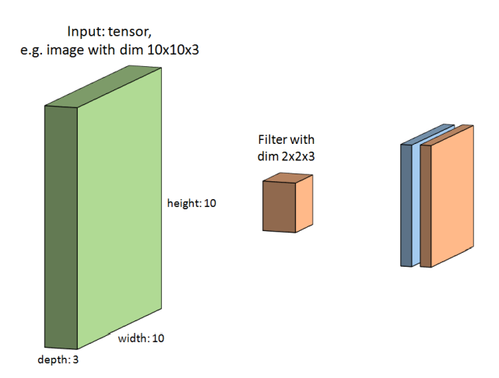
Convolutional Neural Networks
We do the same with a second filter to get a second output feature map. This filter learns something different from the image.
Notes:
- Nice to work together in a bigger team of data science enthusiasts

Slide 23
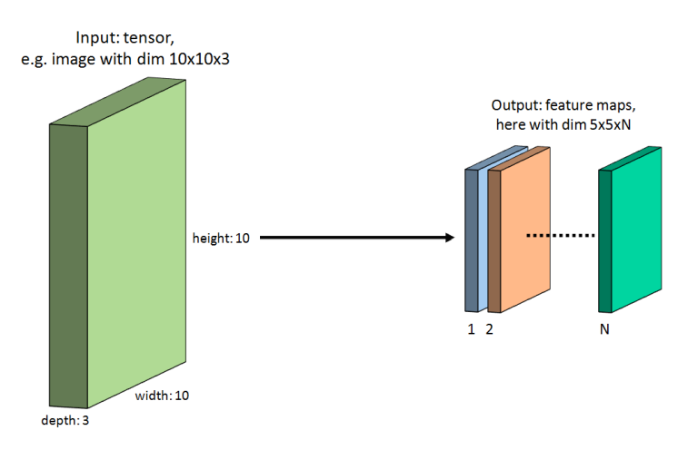
Convolutional Neural Networks
All feature maps together yield us a “new image” with dim h x w x N. We actually append them to a new tensor with depth = # filters.
Notes:
- Nice to work together in a bigger team of data science enthusiasts

Slide 24
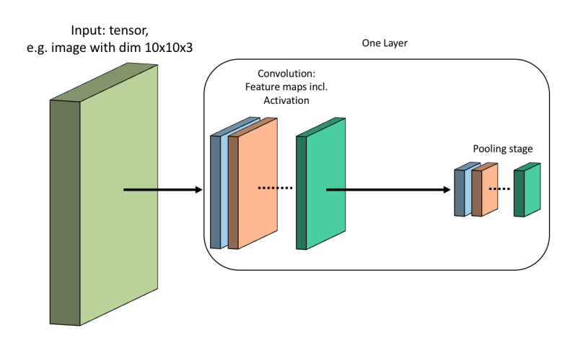
Convolutional Neural Networks
All feature map entries will then be activated via an activation function (e.g. ReLU), just like in a fully connected neural network.
One may use pooling operations to downsample the dimensions of the feature maps. Pooling is applied on each feature map independently.
Notes:
- Nice to work together in a bigger team of data science enthusiasts

Slide 25
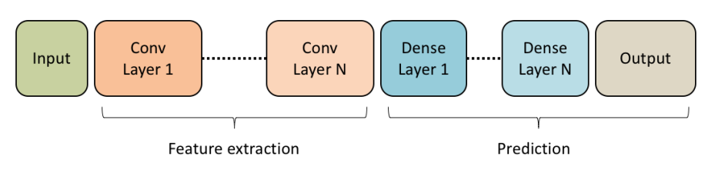
Convolutional Neural Networks
Many of these layers can be placed successively, to extract even more complex features. The second Conv Layer gets the feature maps from the first Conv Layer as input.
The feature maps of the final Conv Layer are flattened (into a vector) and fed into a fully connected layer which, in turn, is followed by more fully connected layers to finally obtain the output.
Notes:
- Nice to work together in a bigger team of data science enthusiasts

Slide 26
Computer Vision Resources
Deep Learning for Computer Vision Standford Course
Convolutional Neural Networks Coursera Course
An Introduction to Convolutional Neural Networks Paper
Notes:
- Nice to work together in a bigger team of data science enthusiasts

Slide 27
Replace background image
Natural Language Processing (NLP)
xx

Slide 28
Resources
Notes:
- Nice to work together in a bigger team of data science enthusiasts

Slide 29
Graph Neural Networks (GNNs)
Definition, Overview, Example Applications, Resources

Slide 30
Acknowledgement
Many of the following slides are inspired by and include screenshots taken from Jure Leskovec’ class Stanford CS224W: Machine Learning with Graphs.

Slide 31
Graphs Introduction
Graphs are a general language for describing and analyzing entities with relations / interactions.
Isolated Data Points
Graph

Slide 32
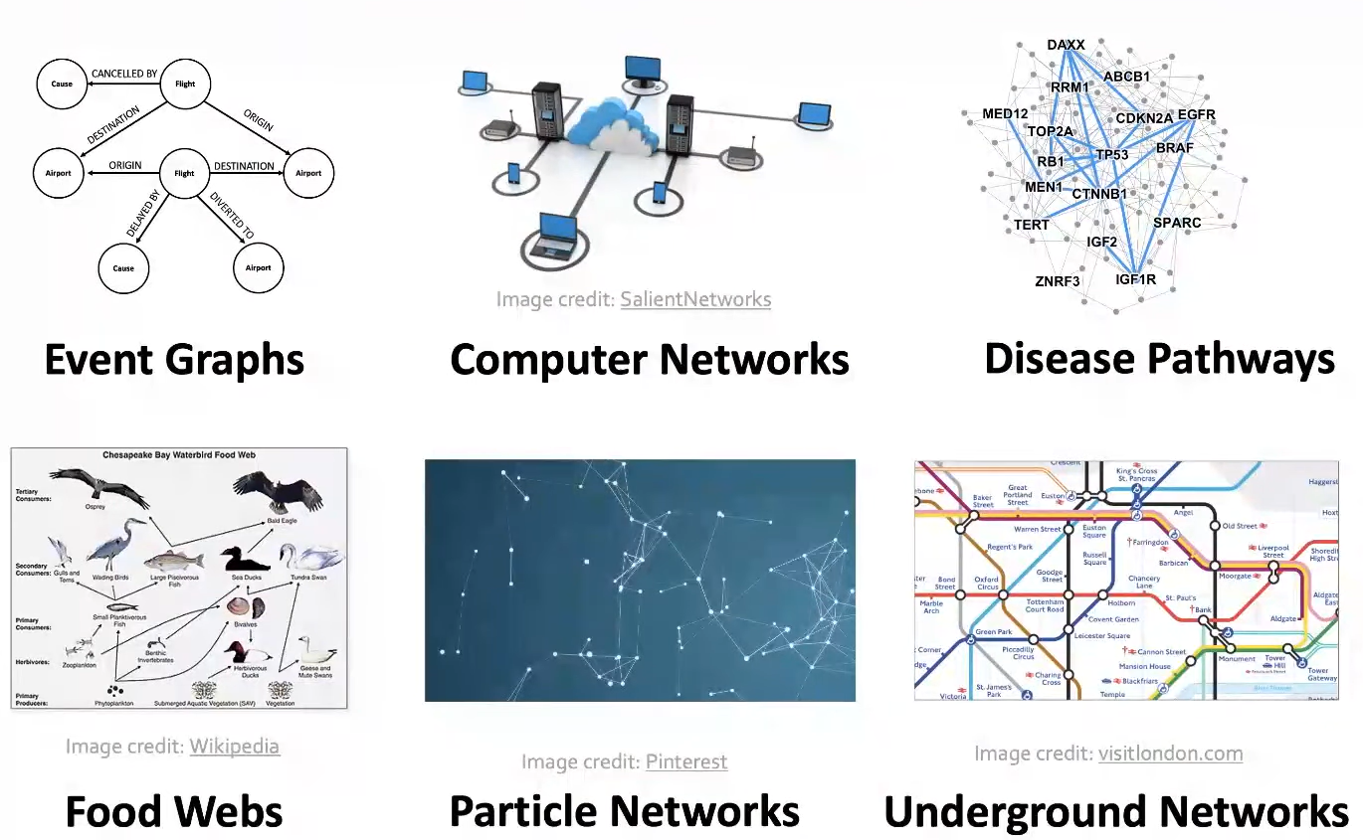
Many Types of Data are Graphs (1)
Notes:
- Modelling / representing this kind of data as a graph with relations between data points, allows us to build much better models of the underlying data.

Slide 33
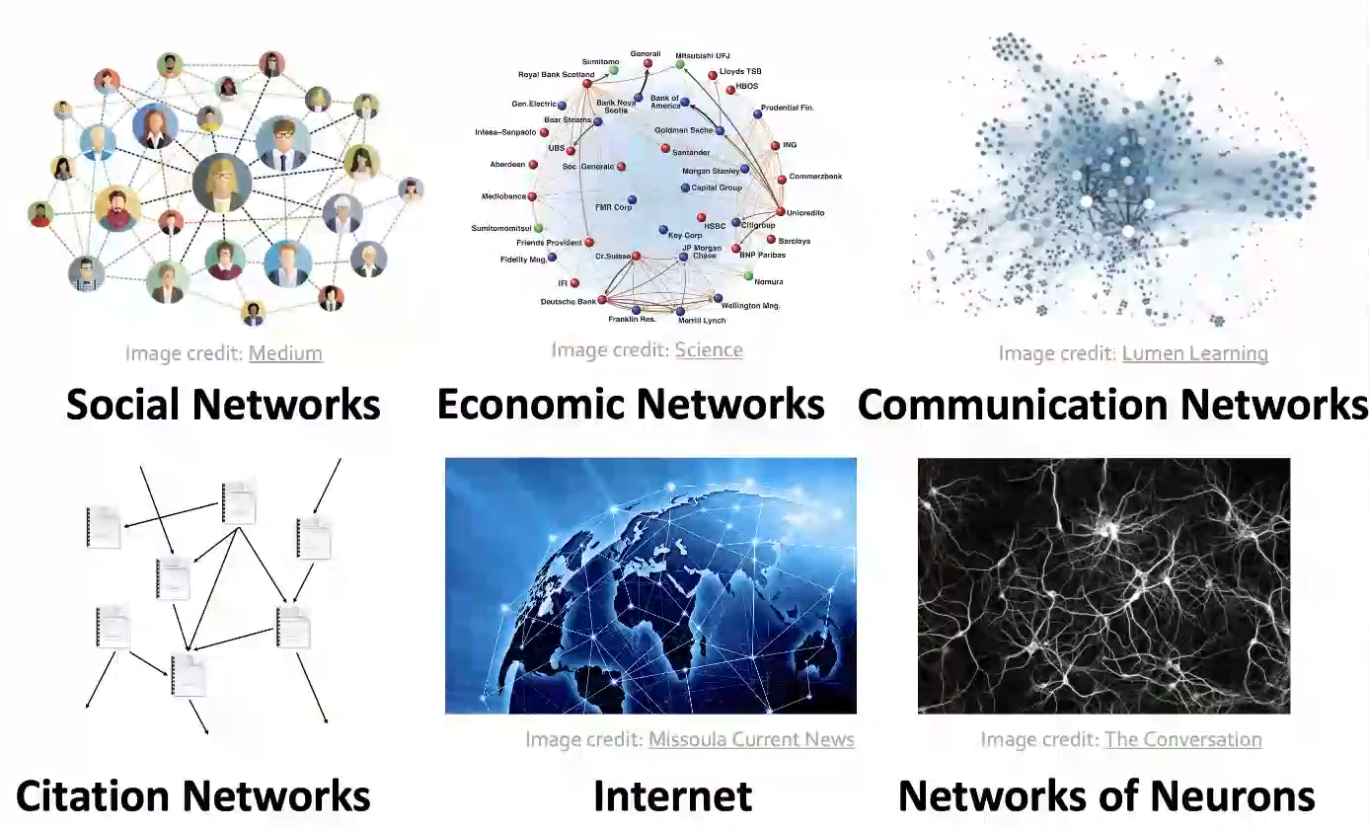
Many Types of Data are Graphs (2)
Notes:
- Modelling / representing this kind of data as a graph with relations between data points, allows us to build much better models of the underlying data.

Slide 34
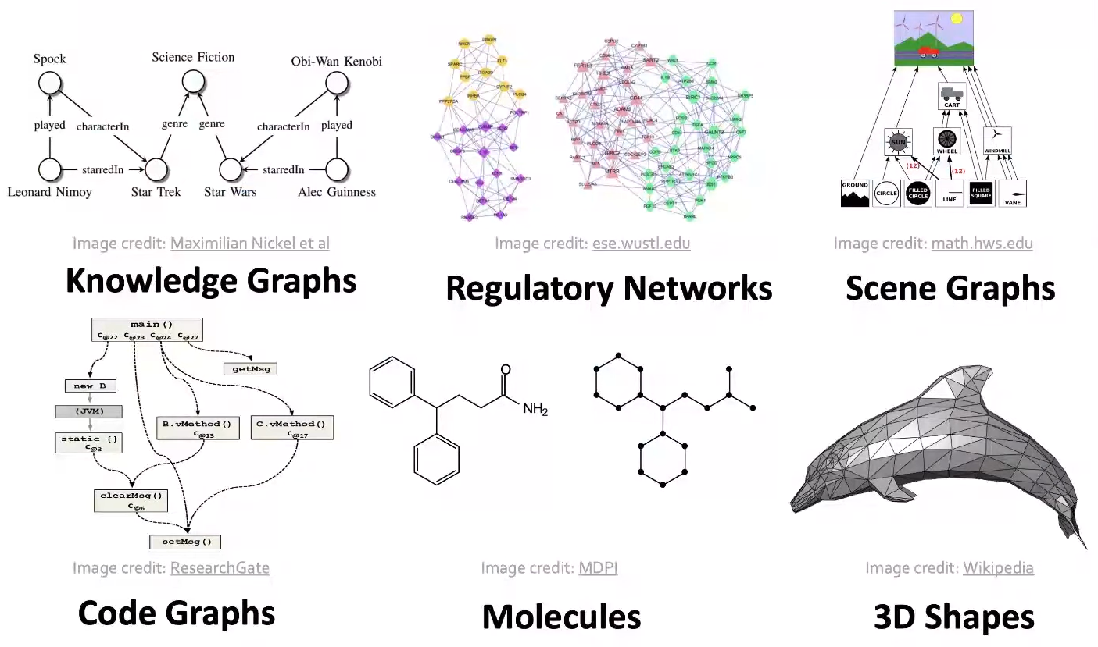
Many Types of Data are Graphs (3)
Other data can also be represented as graphs
User-item relationships in recommender systems
Notes:
- Modelling / representing this kind of data as a graph with relations between data points, allows us to build much better models of the underlying data.

Slide 35
Two Types of Graphs
Networks (Natural Graphs)
The underlying domain can naturally be represented as a graph.
Examples: social networks, communication networks, biomedical interaction networks, neuronal networks
Graphs as a Representation
We can use graphs to represent relationships between data points.
Examples: knowledge graphs, software graphs, similarity networks (connect similar data points), item-user relationships, relational structures (molecules, scene graphs, 3D shapes)
Sometimes the distinction between the two types is blurred.
Notes:
- Modelling / representing this kind of data as a graph with relations between data points, allows us to build much better models of the underlying data.

Slide 36
Graph Neural Networks (GNNs) Introduction (1)
Goal: take advantage of relational structure for better predictions. By explicitly modeling relationships we achieve better performance in complex domains!
So far, we have seen deep learning for tabular data (fully connected neural networks), sequence data (recurrent neural networks, transformers), grid data (convolutional neural networks). Graph Neural Networks operate on graph-structured data.
Sequence Data (e.g. Text)
Tabular Data
Grid Data (e.g. Images)
Graph Data (e.g. Social Networks)
Notes:
Sequence: linear structure
Grid: spatial locality, item-user relationships

Slide 37
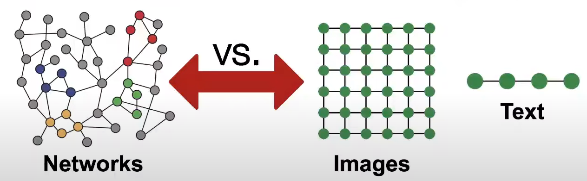
Graph Neural Networks (GNNs) Introduction (2)
One big difference between GNNs and conventional neural networks is that we explicitly model relationships between data examples and don’t have an i.i.d. assumption of examples. The technical term that is used is that we have a relational inductive bias.
There are some challenges with GNNs
Networks are complex!
Arbitrary size and complex topological structure (i.e., no spatial locality like grids)
No fixed node ordering or reference point
Often dynamic with multimodal features
Notes:
- Nice to work together in a bigger team of data science enthusiasts

Slide 38
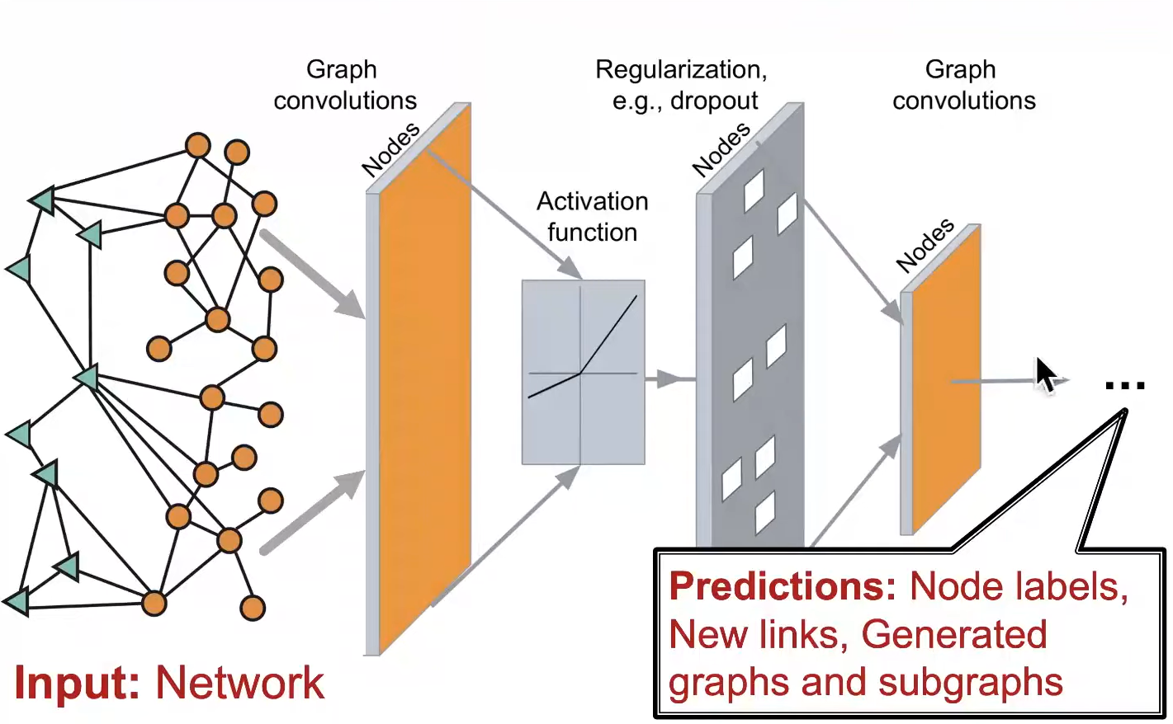
Graph Neural Networks (GNNs) Introduction (3)
Develop neural networks that are broadly applicable and tackle these kind of challenges.
Graphs are one of the new frontiers of deep learning and representation learning research!
The neural network architecture should allow end-to-end modelling with networks as input to different types of prediction as output
Notes:
- Nice to work together in a bigger team of data science enthusiasts

Slide 39
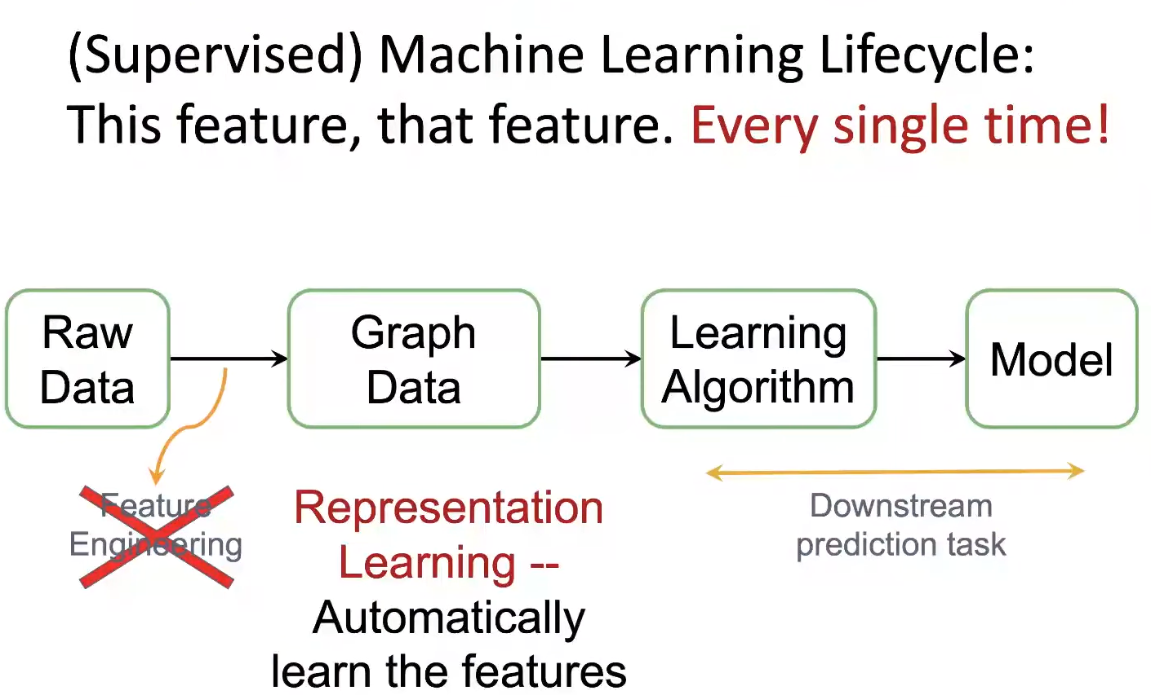
Graph Representation Learning (1)
Notes:
- Nice to work together in a bigger team of data science enthusiasts

Slide 40
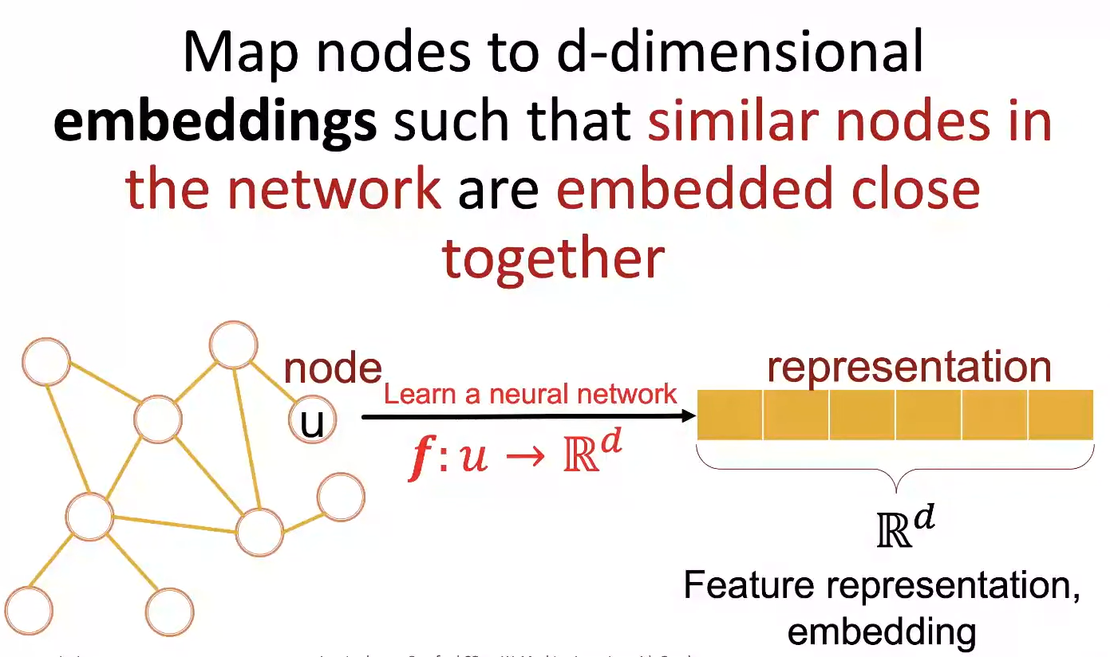
Graph Representation Learning (2)
Notes:
- Nice to work together in a bigger team of data science enthusiasts

Slide 41
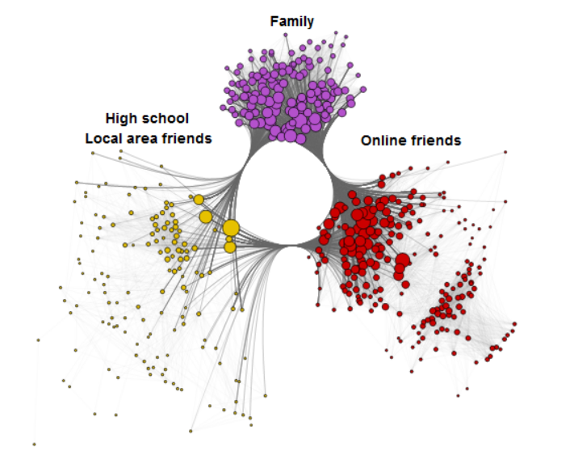
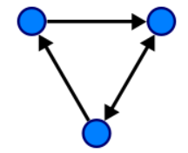
Different Notions of Graphs
A graph G can be defined as G = (V, E), where V is the set of nodes, and E are the edges between them.
There are many variations of graphs
Directed vs undirected
With or without node features
With or without edge features
Multiple edges
Multiple edge types
Self loops
…
Notes:
- Nice to work together in a bigger team of data science enthusiasts

Slide 42
Prediction Tasks with Graphs
Node Prediction
Link / Edge Prediction
Community Prediction
Graph Prediction Graph Generation
Notes:
- Nice to work together in a bigger team of data science enthusiasts

Slide 43
Classic Example Tasks of GNNs
Node classification: Predict a property of a node
Example: categorize online users / items in a recommender system
Link prediction: Predict whether there are missing links between two nodes
Example: knowledge graph completion, social network recommendations
Graph classification: Categorize different graphs
Example: molecule property prediction
Clustering: Detect if nodes form a community
Example: Social circle detection
Other tasks:
Graph generation: drug discovery
Graph evolution: network simulation
Notes:
- Nice to work together in a bigger team of data science enthusiasts

Slide 44
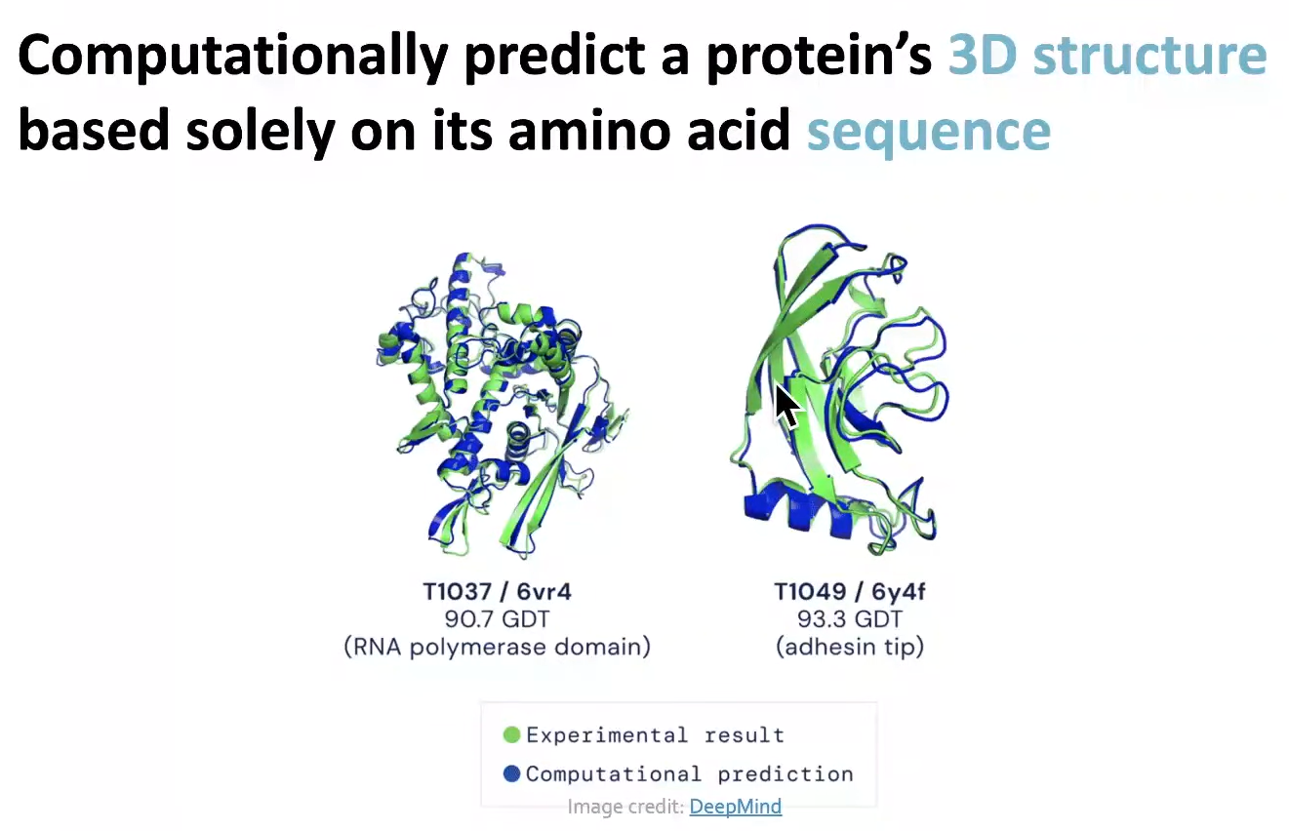
High Impact Example Application: Protein Folding
Key idea: “spatial graph”:
Nodes: amino acids in a protein sequence
Edges: proximity between amino acids
Notes:
- Nice to work together in a bigger team of data science enthusiasts

Slide 45
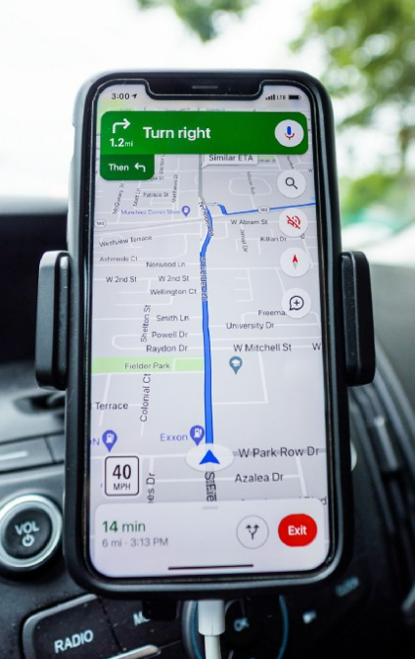

High Impact Example Application: Traffic Prediction
https://www.deepmind.com/blog/traffic-prediction-with-advanced-graph-neural-networks
Notes:
- Nice to work together in a bigger team of data science enthusiasts

Slide 46
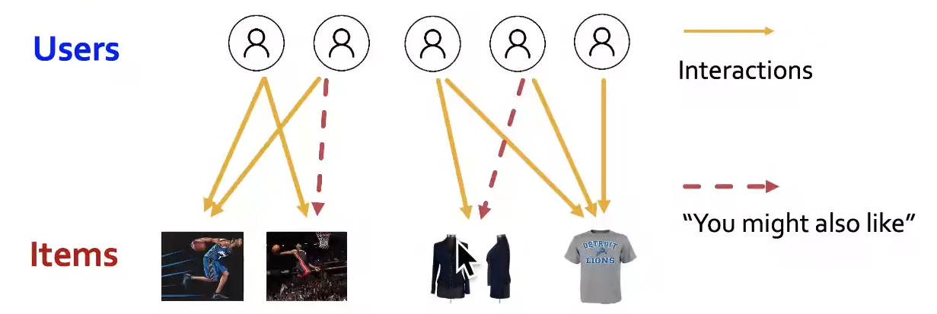
High Impact Example Application: Recommender Systems
Notes:
- Nice to work together in a bigger team of data science enthusiasts

Slide 47
GNNs Resources
A Gentle Introduction to Graph Neural Networks on Distill
Stanford CS224W: Machine Learning with Graphs Lecture
Podcast with Matthias Fey, creator of the PyTorch Geometric library
Notes:
- Nice to work together in a bigger team of data science enthusiasts

Slide 48
Replace background image
Recommender Systems
xx

Slide 49
Resources
Notes:
- Nice to work together in a bigger team of data science enthusiasts

Slide 50
Replace background image
Generative Adversarial Networks (GANs)
xx

Slide 51
Resources
Notes:
- Nice to work together in a bigger team of data science enthusiasts

Slide 52
Replace background image
Deep Reinforcement Learning (Deep RL)
xx

Slide 53
Resources
Notes:
- Nice to work together in a bigger team of data science enthusiasts

Slide 54
Replace background image
Model Interpretability
xx

Slide 55
Resources
Notes:
- Nice to work together in a bigger team of data science enthusiasts

